Slide 1
Aggregates in SQL
SQL Day 3 class

Slide 2
Learning Objectives
By the end of this lesson, you will be able to:
Calculate the average of a numerical value for a group.
Determine the minimum and maximum numerical value for a group.
Count the number of values and unique values for a field.
Aggregate strings into a delimited list.

Slide 3
What is an Aggregate
Aggregates consolidate multiple data points into representative and meaningful statistics.
They aggregate multiple values from a column or table into a consolidated result
Aggregates are useful for summarizing and analyzing data instead of looking at individual records
They provide central tendencies, totals, extremes, and more from a dataset
We can run aggregates on a whole table or on groups within the table

Slide 4
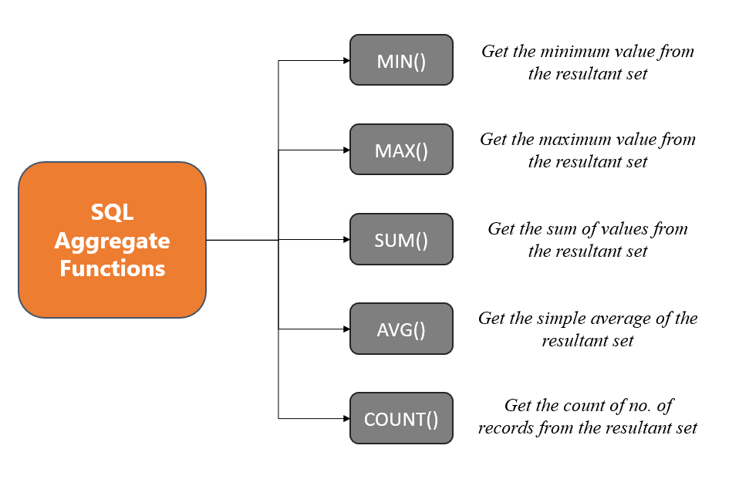
What is an Aggregate
Common Aggregate Functions:

Slide 5
What is an Aggregate
Common Aggregate Functions
SUM()
Totals the values in a column
Useful for running totals, sums of money, sums of quantities
Example: SUM(sales)
totals all sales values
AVG()
Averages the values in a column
Useful as a measure of central tendency
Example: AVG(test_scores)
gets the average test score

Slide 6
What is an Aggregate
Common Aggregate Functions
MIN() and MAX()
Find minimum and maximum values
Useful for finding value ranges and extremes
Example: MIN(expense)
gets lowest expense amount
COUNT()
Counts the number of rows in a column
Useful for counting records, events, and more
Example: COUNT(customers)
counts total customers

Slide 7
Using Aliases with Aggregates
Aliases are useful for renaming columns in aggregate queries
They make column names more readable
Syntax:
AGGREGATE_FUNCTION(column) AS alias_name
Example:
SELECT SUM(TotalDue) AS TotalSales, AVG(LineTotal) AS AverageLineTotal FROM Sales.SalesOrderHeader;

Slide 8
Using Aliases with Aggregates
Benefits:
Results are more understandable
Allows totals/averages to be reused easily
Can reuse aliases for analysis and reporting
Best Practice Tips:
Use descriptive aliases like TotalSales, AveragePrice
Be consistent with alias naming
Avoid spaces and special characters
In summary, use aliases to assign descriptive names to aggregated results! It improves readability and reuse.

Slide 9
Using Sum() to Total Values
The SUM() aggregate adds together all numeric values in a column
Useful for:
Getting totals of sales, expenses, balances
Calculating running totals over time
Summarizing numeric data down to a total
Syntax: SUM(column_name)
Examples:
SUM(sales) - Sums all sales
SUM(expenses) - Sums all expenses
SELECT SUM(balance) FROM bank_accounts;

Slide 10
Using Sum() to Total Values
Tips:
Sum multiples columns simultaneously
Use filters to sum subsets of data
Limitations:
Only works for numeric data
Ignores non-numeric and NULL values

Slide 11
Using AVG() to Get Averages
The AVG() aggregate calculates the average value in a column
Useful for finding:
Central tendencies of data
Mean values of measurements
Average metrics over time
Syntax: AVG(column_name)
Examples:
AVG(test_scores)
AVG(expense BY month)
SELECT AVG(salary) FROM employees;

Slide 12
Using AVG() to Get Averages
Tips:
Average multiple columns at once
Handles numeric columns only
Ignores NULL values
Limitations:
Sensitive to outliers
Doesn't show distribution

Slide 13
Using MIN(), MAX()
MIN() and MAX()
Find minimum and maximum values in a column
Useful for finding extremes and value ranges
Example:
SELECT MIN(ListPrice) AS MinPrice, MAX(ListPrice) AS MaxPrice FROM Production.Product;

Slide 14
Using MIN(), MAX()
Tips:
Filter by conditions first
Combine with GROUP BY to count groups
Handle any data type
Limitations:
MIN()/MAX() work on numeric/date data

Slide 15
Using Count and COUNT(DISTINCT)
Understanding COUNT()
COUNT()
Counts total number of rows
Includes null and duplicate rows
COUNT(column)
Counts rows with non-null values in column
Leaves out rows where column is null
COUNT(DISTINCT column)
Counts total unique/distinct values
Eliminates duplicates to count only distinct

Slide 16
Using Count and COUNT(DISTINCT)
Examples:
SELECT COUNT(*) FROM table;
All rows
SELECT COUNT(column1) FROM table;
Only non-null column1 rows
SELECT COUNT(DISTINCT column2) FROM table;
Unique values in column2
Use Cases:
Row counts in table or group
Count of non-null column values
Tally distinct values

Slide 17
Using the Group By Clause
GROUP BY groups rows with matching values
It is used with aggregate functions to group calculations
Basic syntax:
SELECT columns, aggregates FROM table
GROUP BY grouping_column;
Examples:
GROUP BY CustomerID, OrderYear
GROUP BY Region, COUNTRY(Location)

Slide 18
Using the Group By Clause
Key Tips:
Group numeric and date columns easily
Use aliases to rename groups
Single or multiple grouping columns
Filter groups with HAVING clause
Combine with ORDER BY to sort groups
Limitations:
GROUP BY requires you to either group by or aggregate any non-grouping columns in the select statement.
Getting this right can be tricky.

Slide 19
Using the HAVING Clause
The HAVING clause filters query results based on aggregate conditions after the GROUP BY
Key Differences from WHERE:
WHERE filters rows before aggregation
HAVING filters groups after aggregation
HAVING works on aggregated results
Basic SQL Syntax:
SELECT group_columns, aggregates
FROM table GROUP BY grouping_columns
HAVING conditional_check;

Slide 20
Using the HAVING Clause
Example Using HAVING:
SELECT year, SUM(sales) AS total_sales
FROM data
GROUP BY year
HAVING SUM(sales) > 1000000;
Use Cases:
Filter to significant groups
Check for aggregate thresholds
Focus analysis on subset of data

Slide 21
Summary
Aggregates perform calculations across rows of data to produce summarized results.
GROUP BY categorizes rows into groups to apply aggregates per group. This segments the data to show aggregates by categories
HAVING enables filtering group results by aggregate criteria to focus on significant groups. It is the aggregation equivalent of WHERE
Together, aggregates along with GROUP BY, HAVING and ORDER BY provide the ability to summarize, analyze, and understand SQL data at a higher level

Slide 22
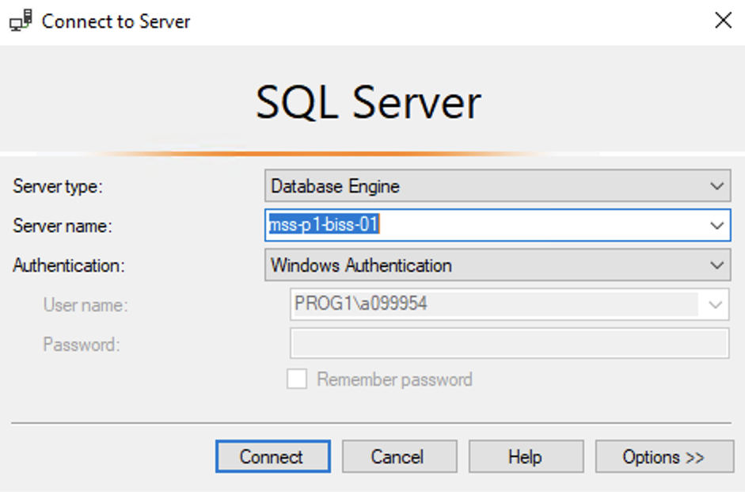
Hands On Examples
Using the AdventureWorks2012 Database
Please open up SSMS
Connect to BISS
Server = mss-p1-biss-01

Slide 23
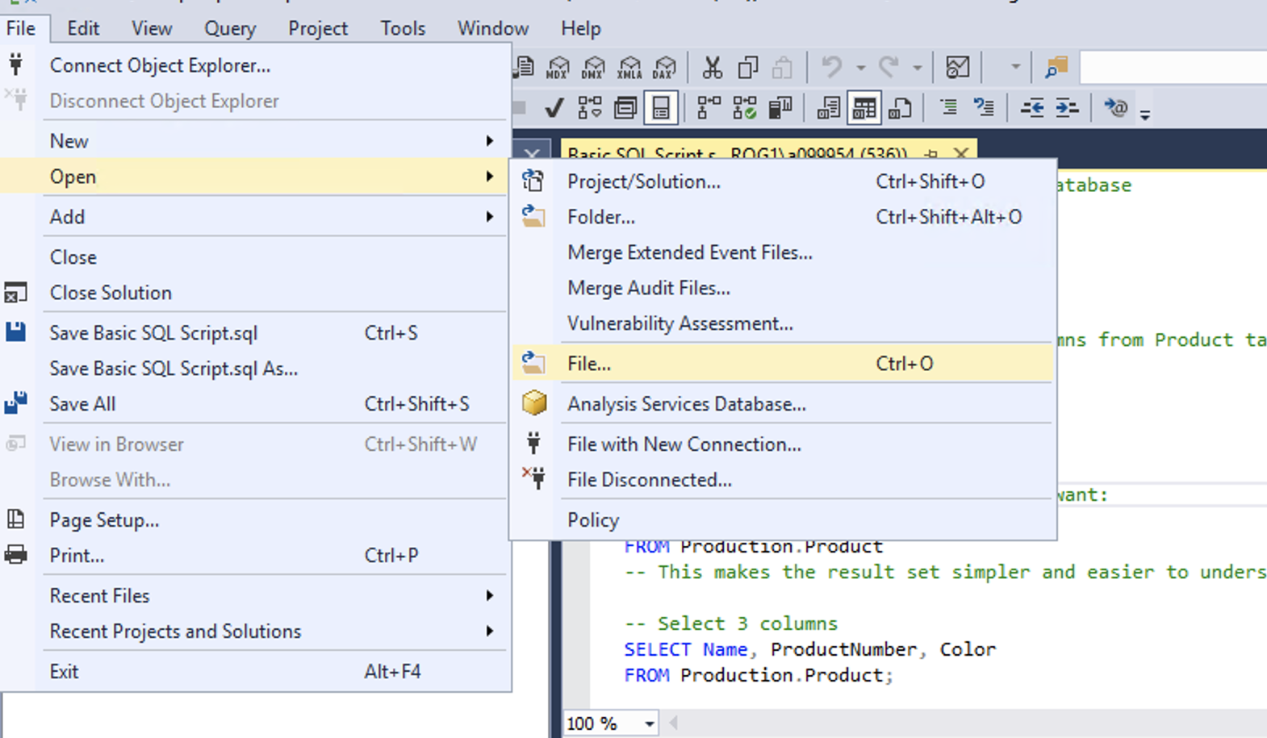
Hands On Examples
Click File -> Open -> File

Slide 24
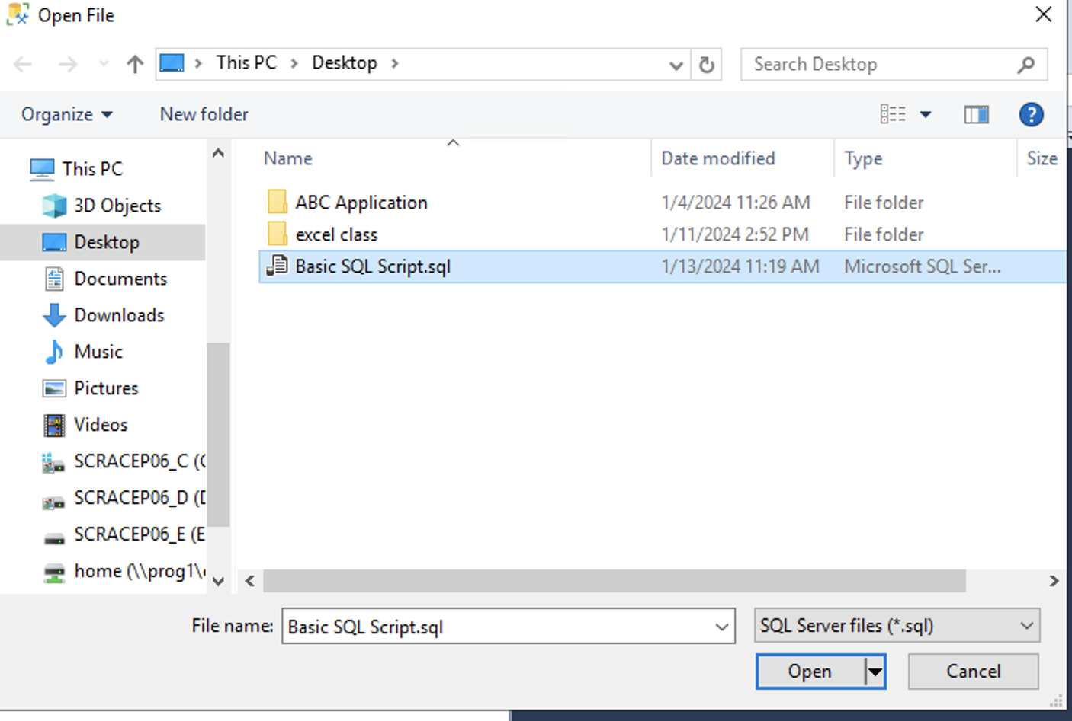
Hands On Examples
Open the SQL Day 3 Aggregates Script.sql file
Notes:
Walk through each function

Slide 25
Exercise
Open the Day 3 Exercise.sql file
Answer the questions from each section
Notes:
Answers are stored in the Exercise Answers.sql file

